Slide 1
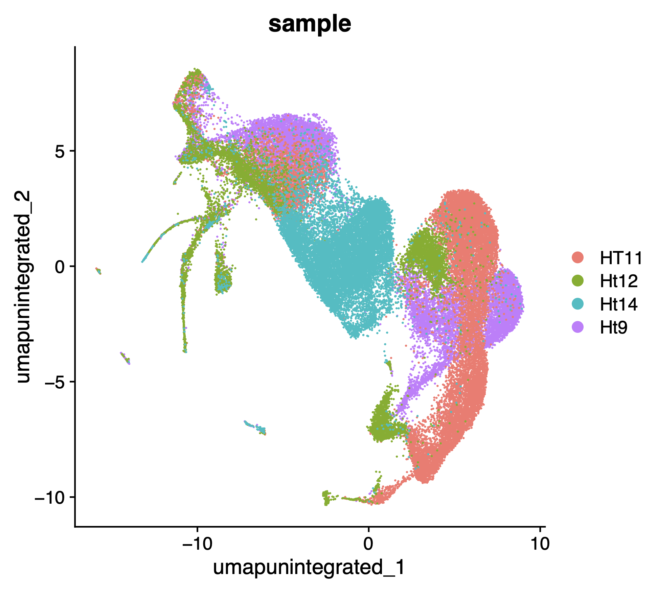
240201_1_parse_post-qc_pre-integrate

Slide 2
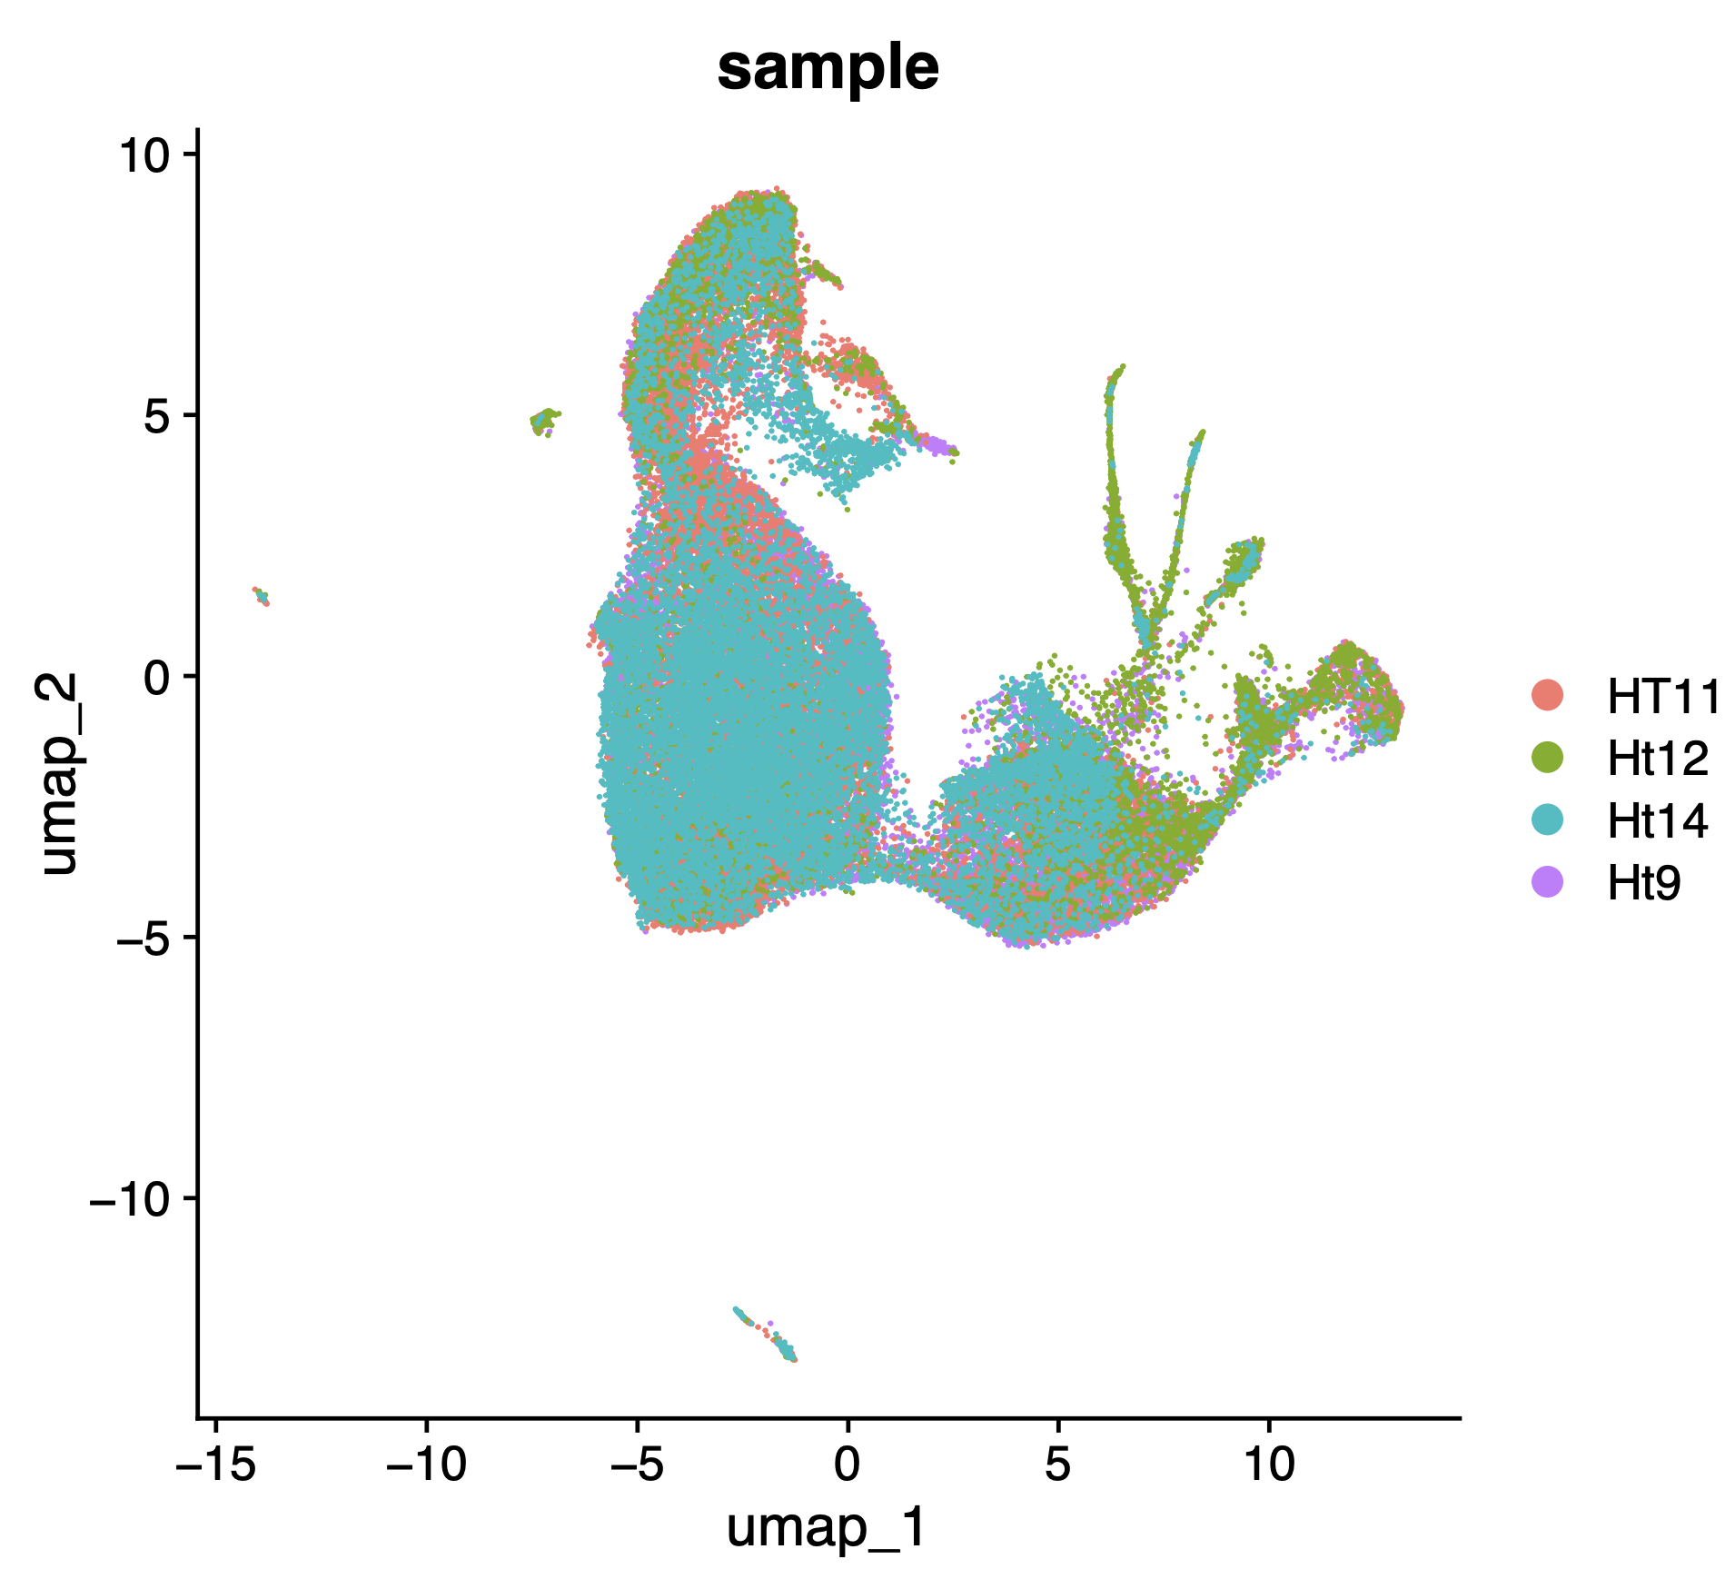
240201_2_parse_post-qc_post-integrate_group-by-sample

Slide 3
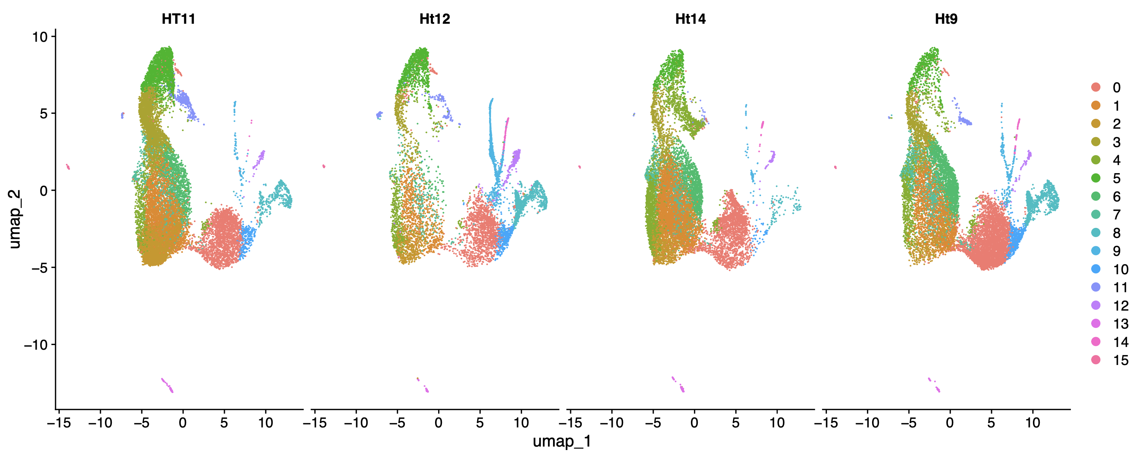
240201_3_parse_post-qc_post-integrate_split-by-sample

Slide 4
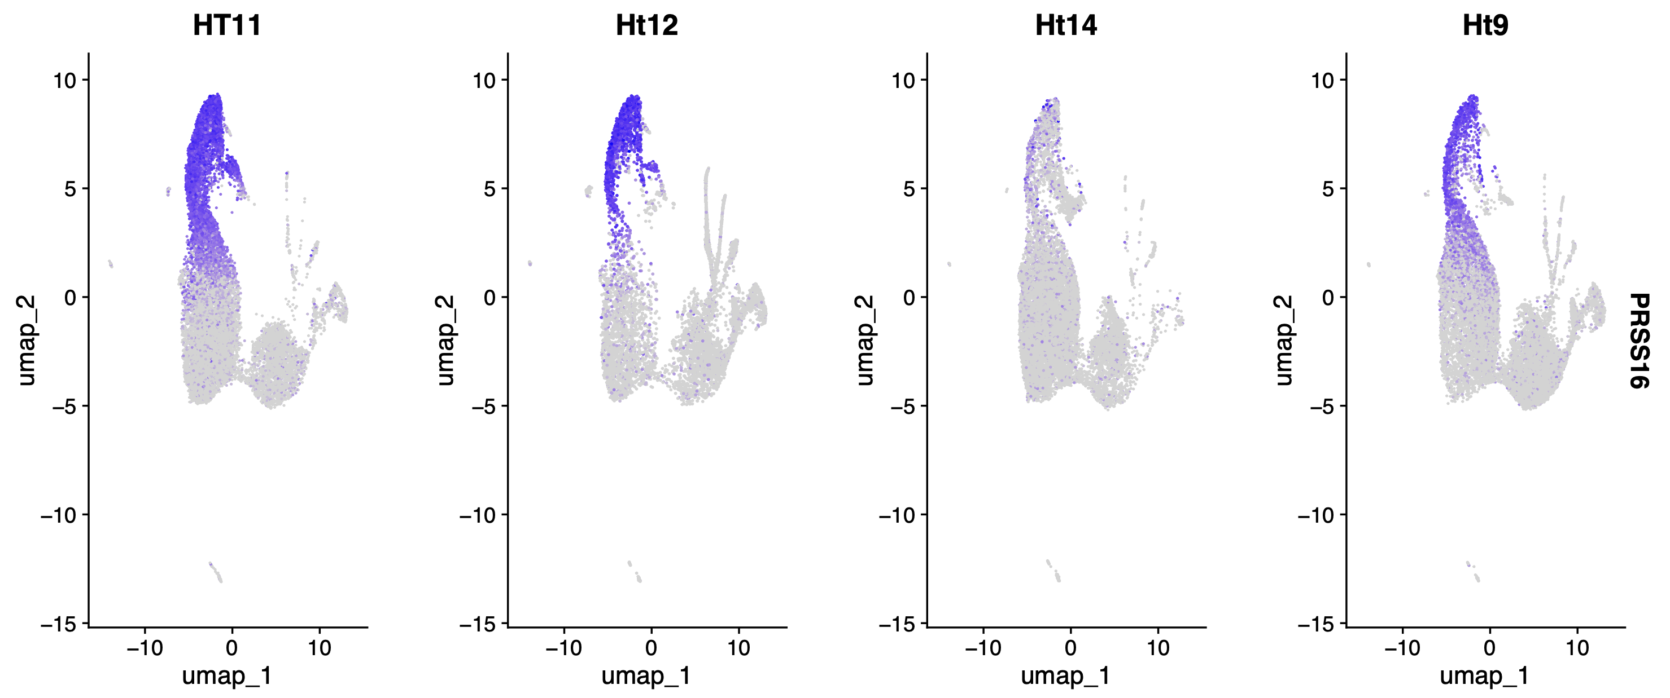
240201_6_parse_post-qc_post-integrate_PRSS16

Slide 5
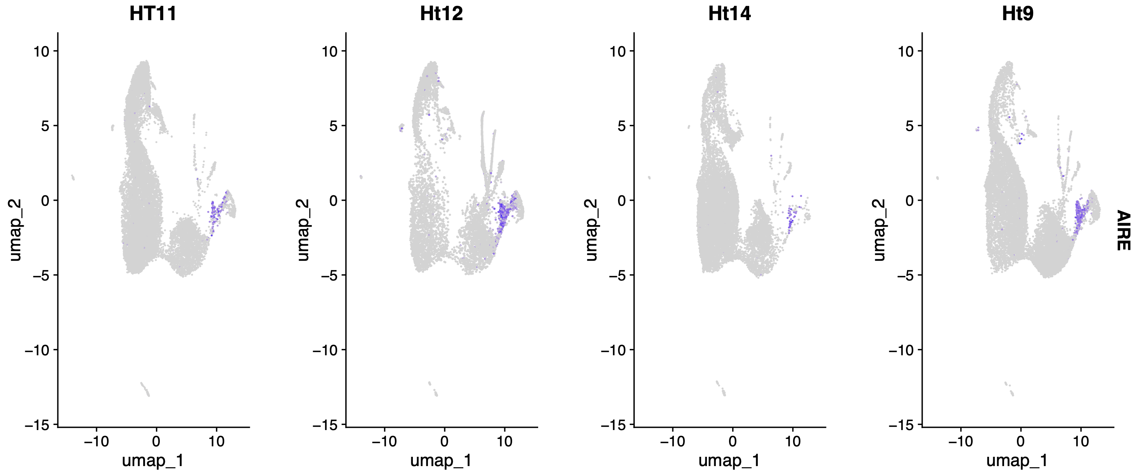
240201_7_parse_post-qc_post-integrate_AIRE

Slide 6
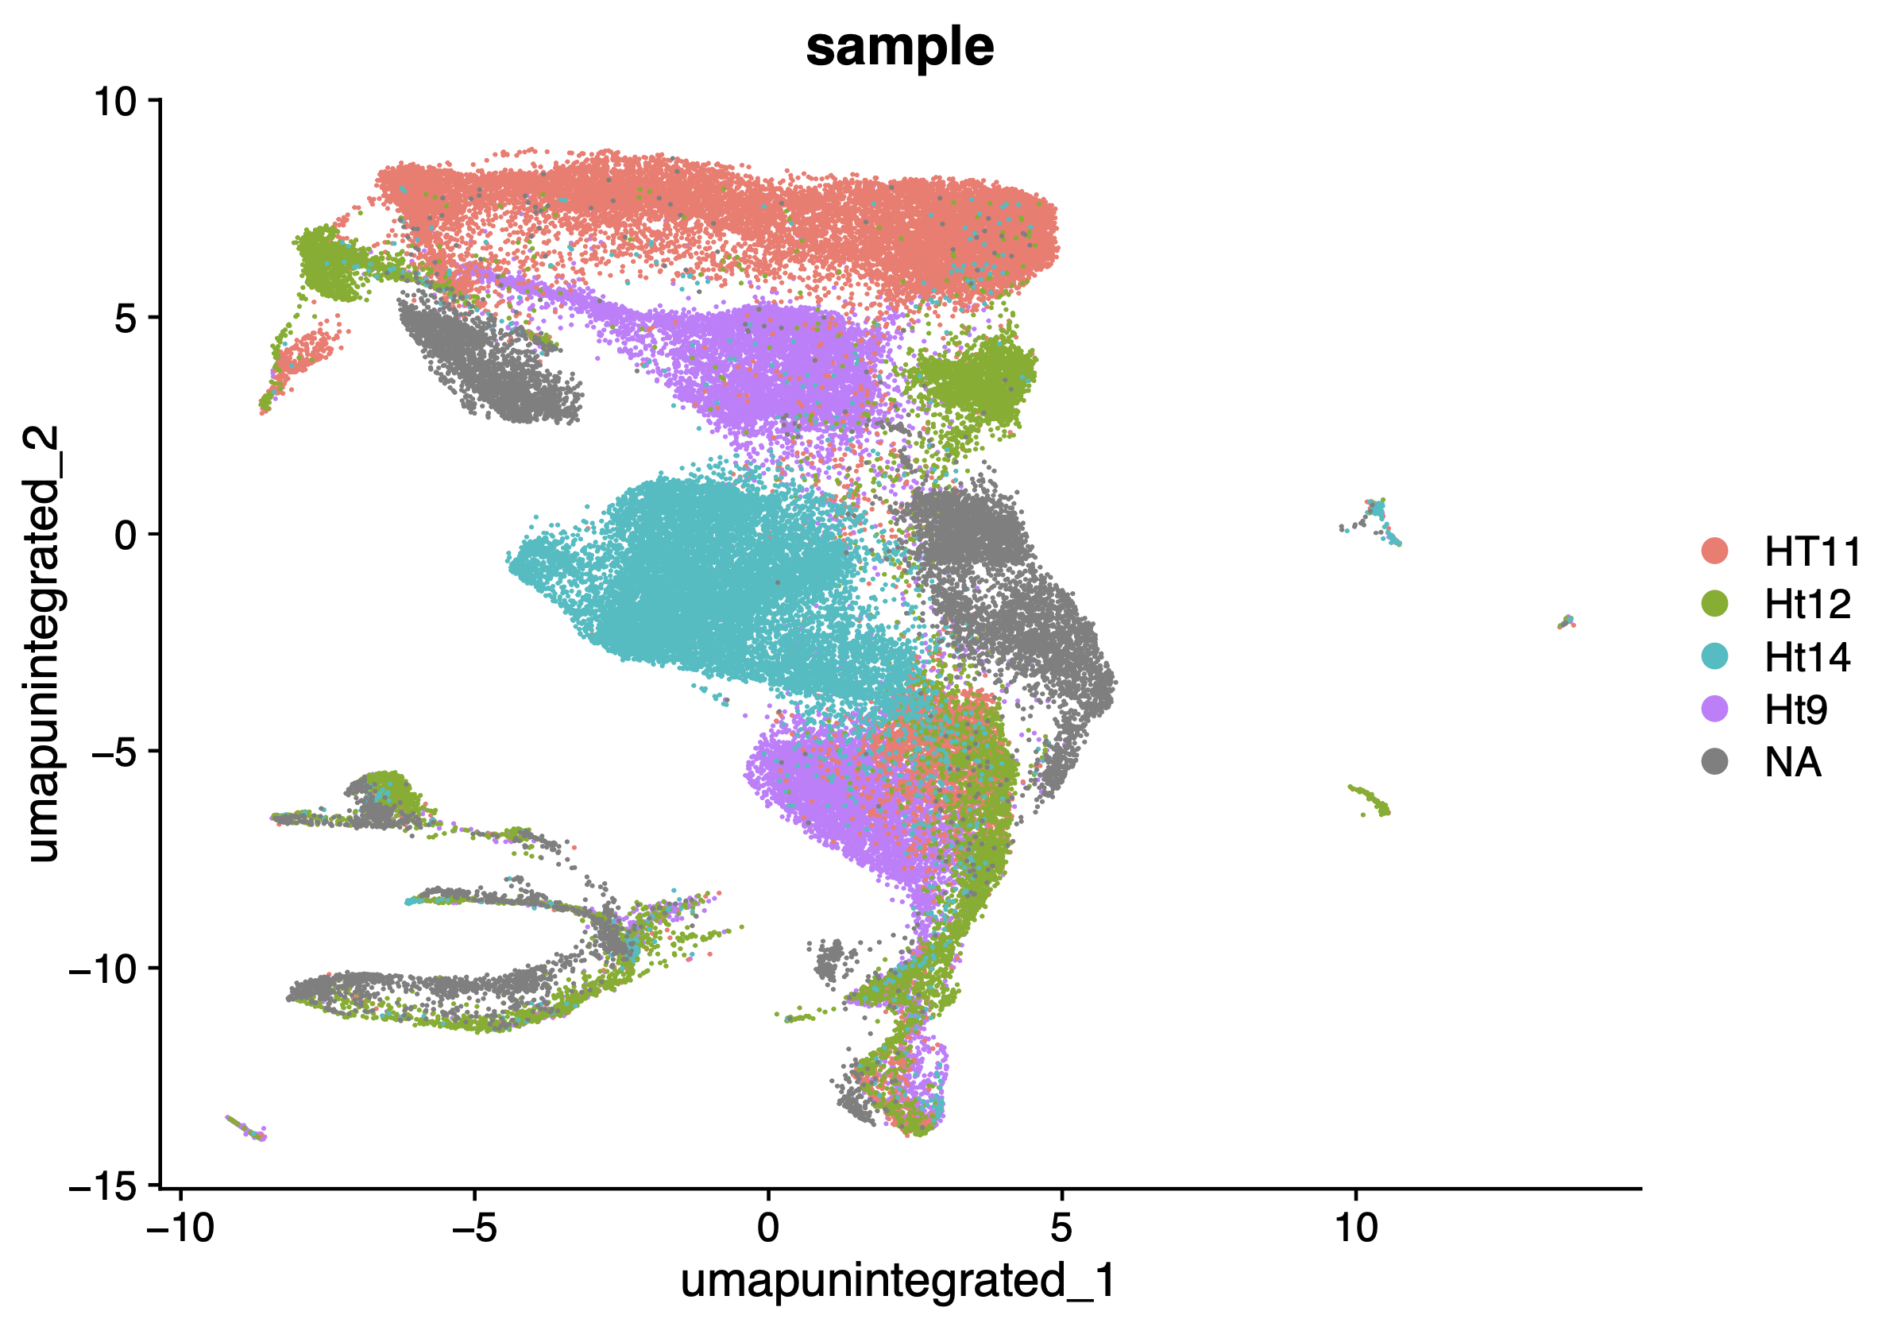
240201_8_parse_post-qc_post-integrate_post-merge-with-multiome_not-integrated_group-by-parse

Slide 7
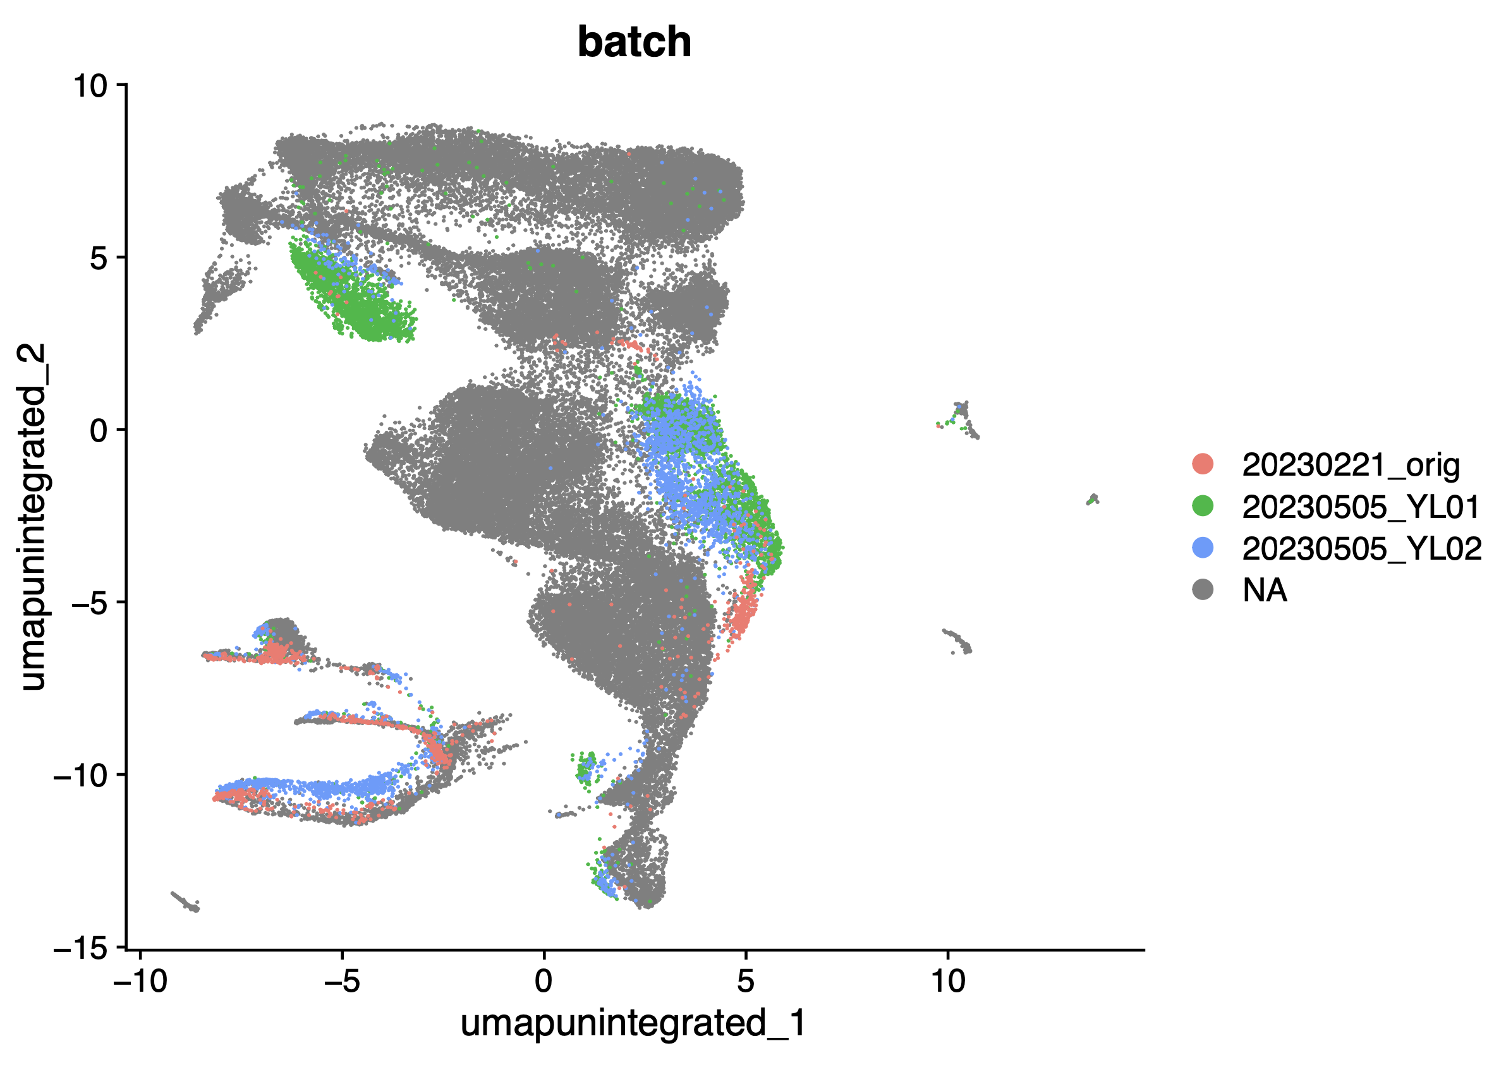
240201_9_parse_post-qc_post-integrate_post-merge-with-multiome_not-integrated_group-by-multiome

Slide 8
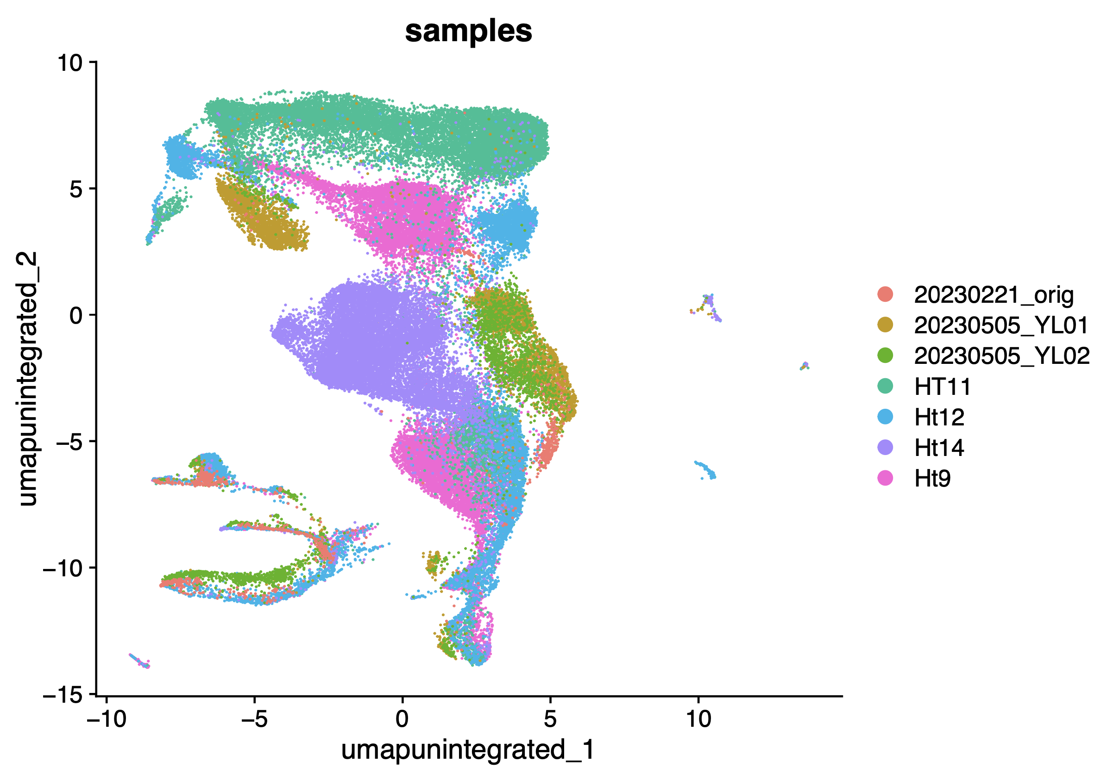
240201_10_parse_post-qc_post-integrate_post-merge-with-multiome_not-integrated_group-by-combined-IDs

Slide 9
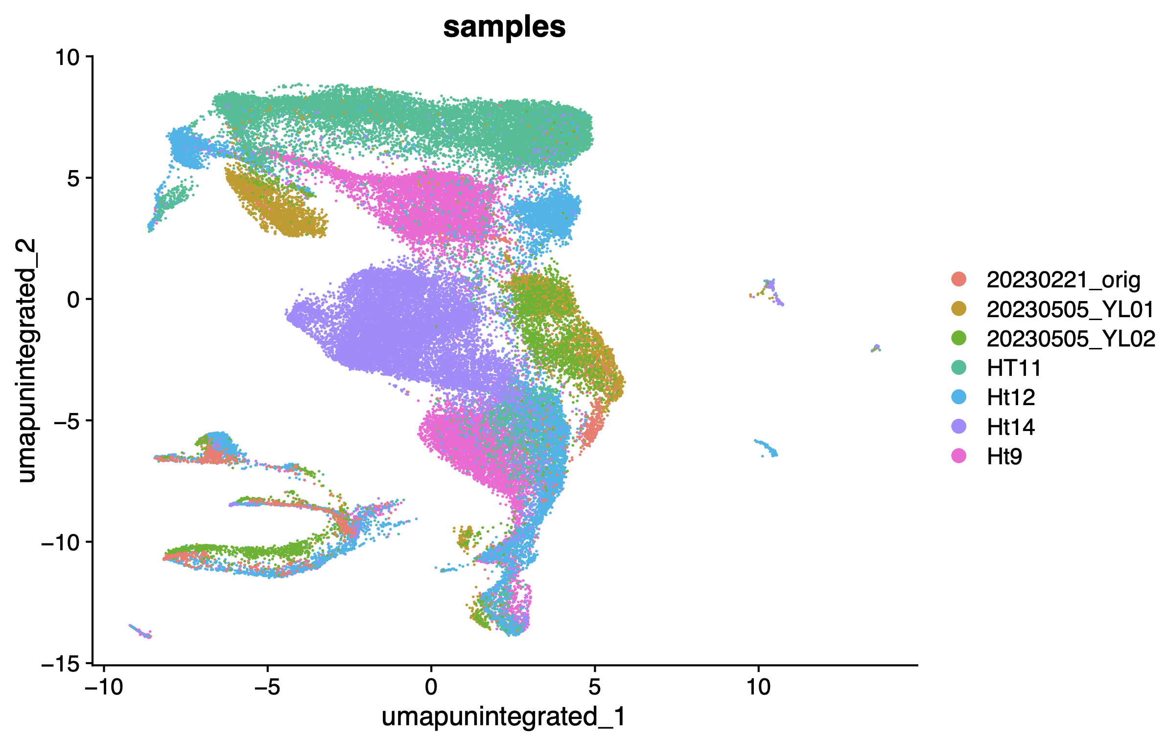
240201_11_post-integrate_parse_multiome_group-by-samples_no-reduction-parameter-in-dimplot

Slide 10
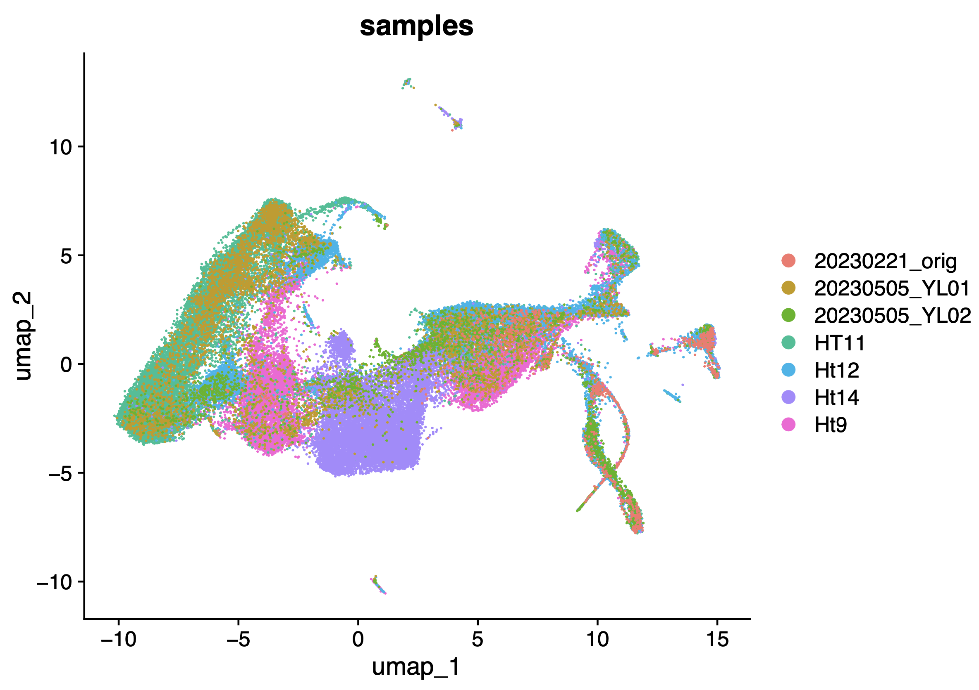
240201_12_post-integrate_parse_multiome_group-by-samples

Slide 11
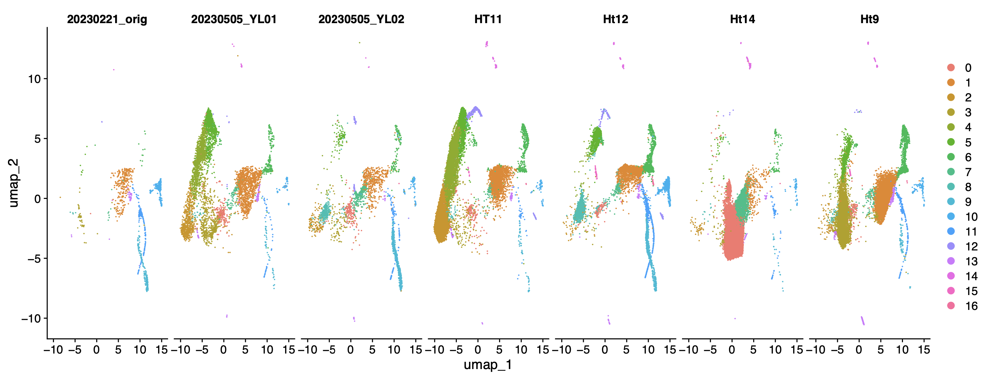
240201_13_post-integrate_parse_multiome_split-by-samples

Slide 12
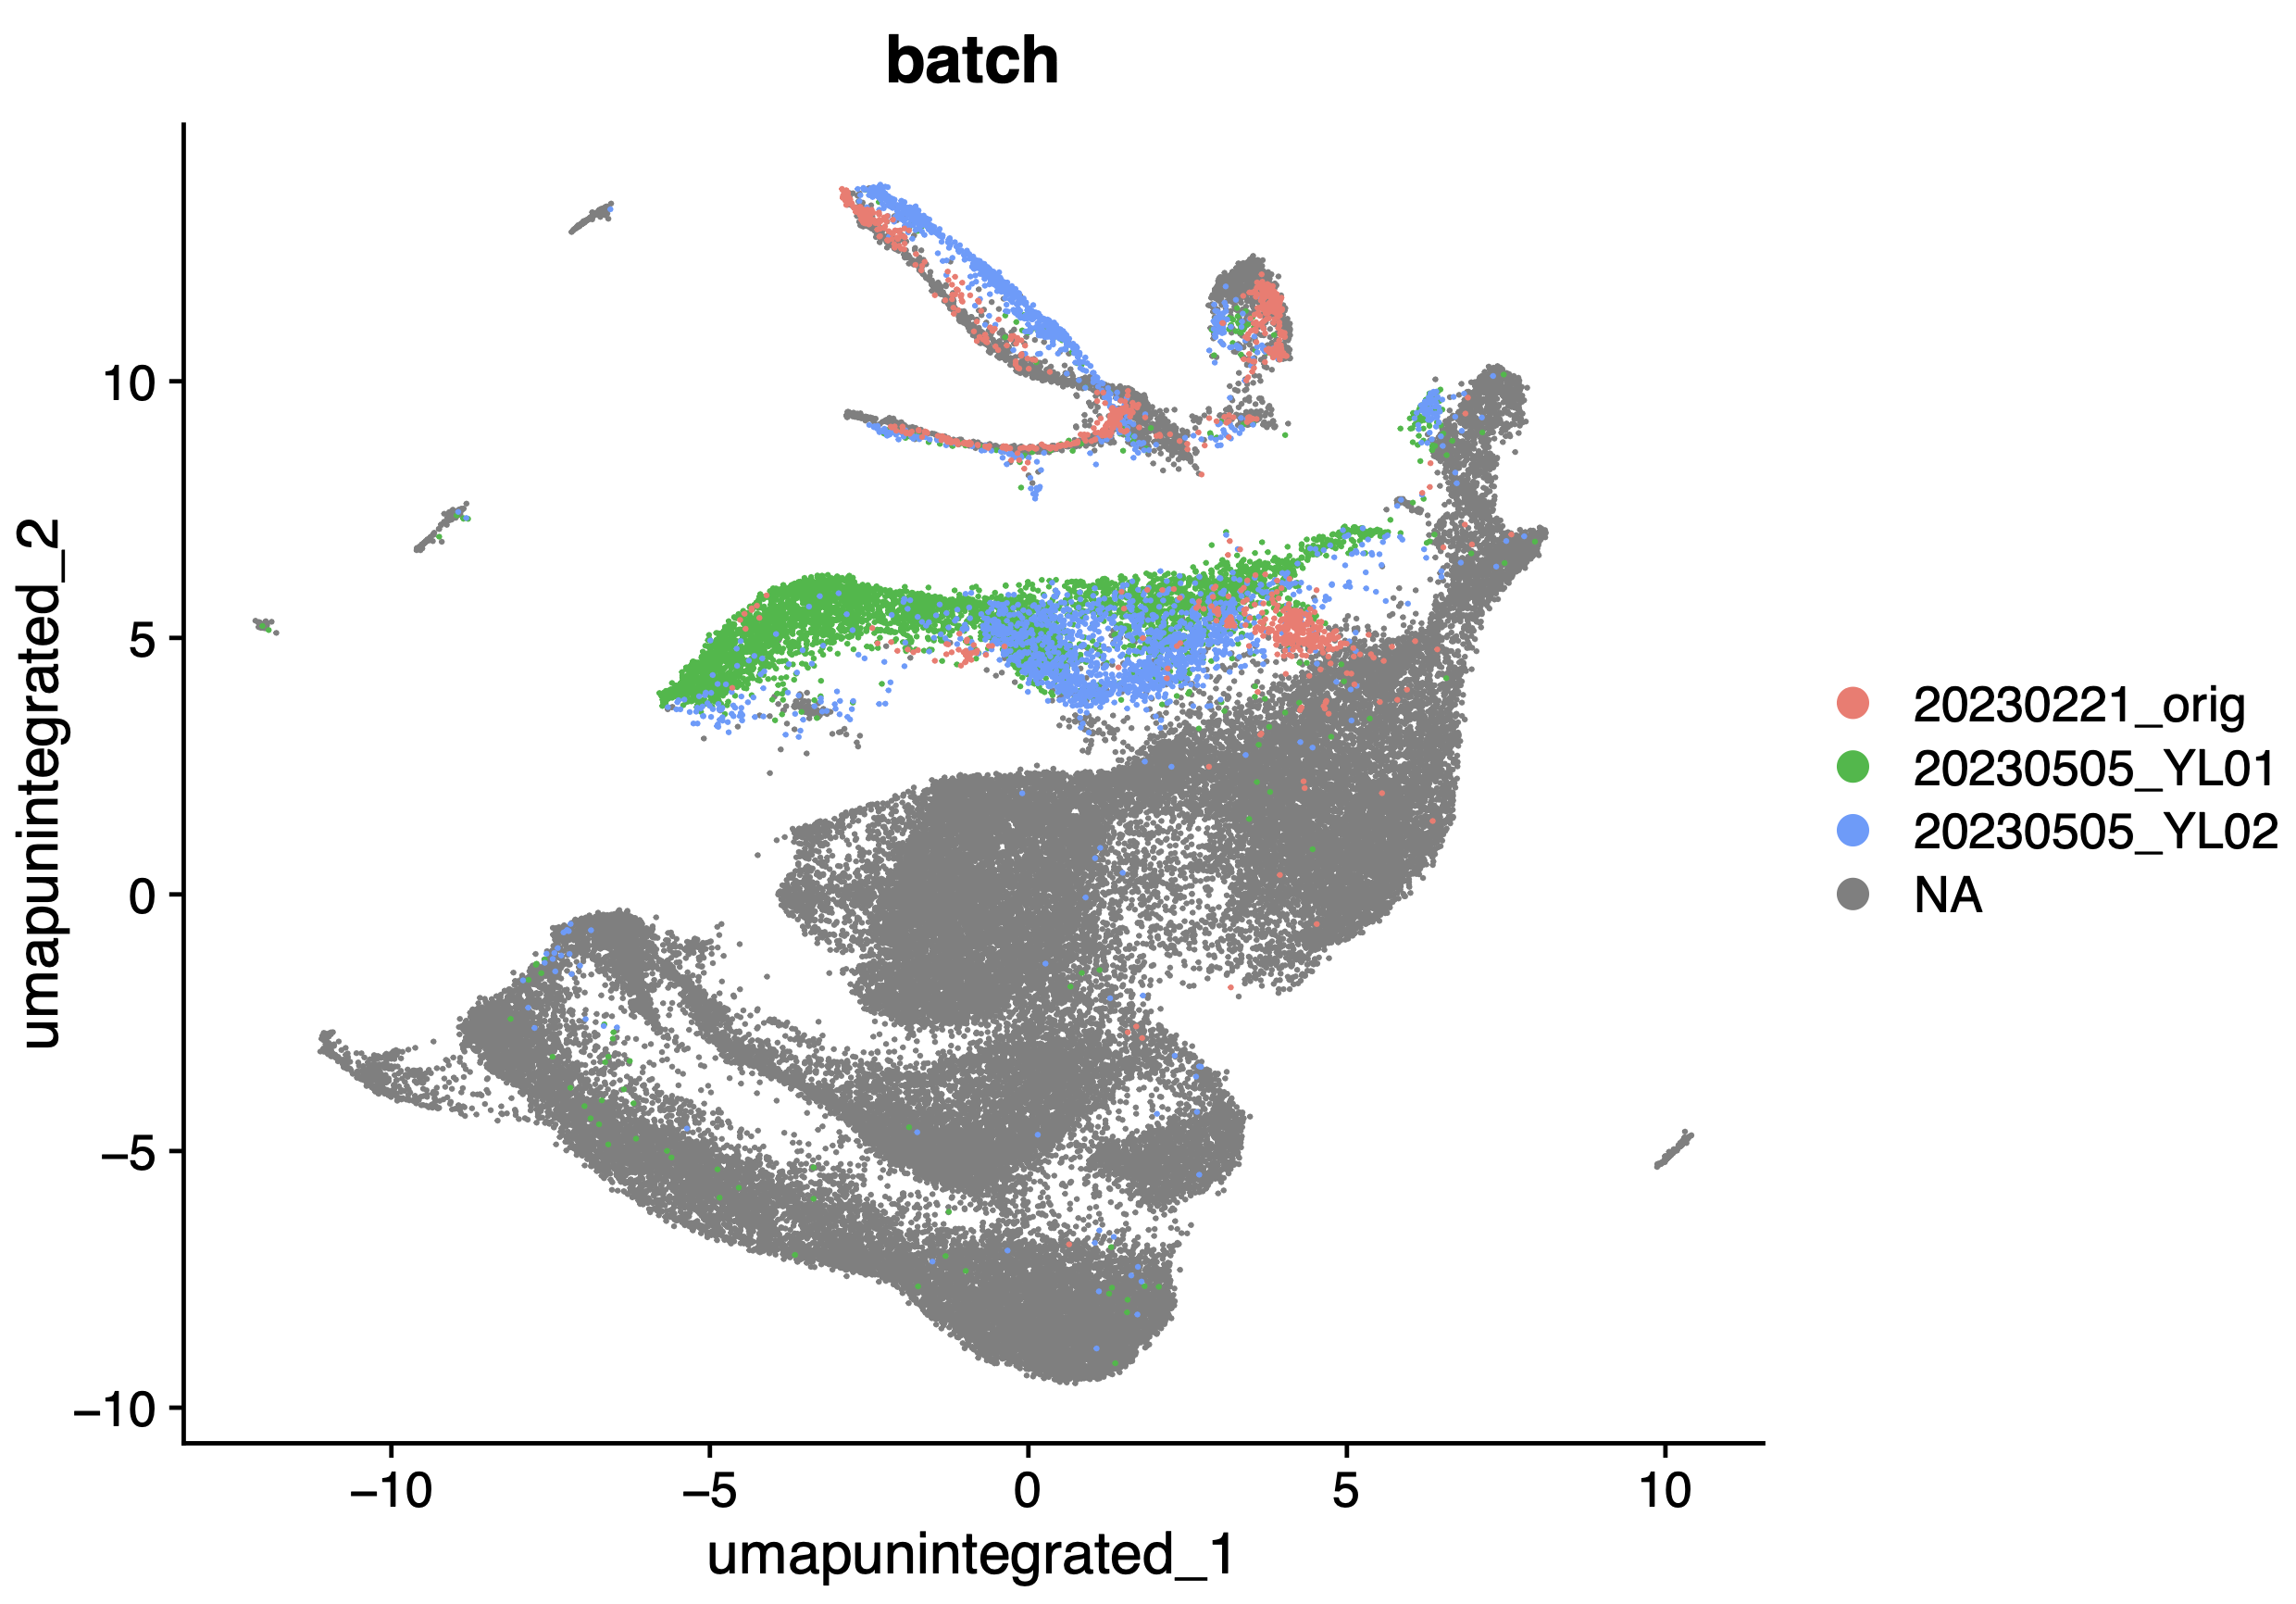
240201_14_split_to_7_samples_first_merged_pre-integrate_group-by-multiome

Slide 13
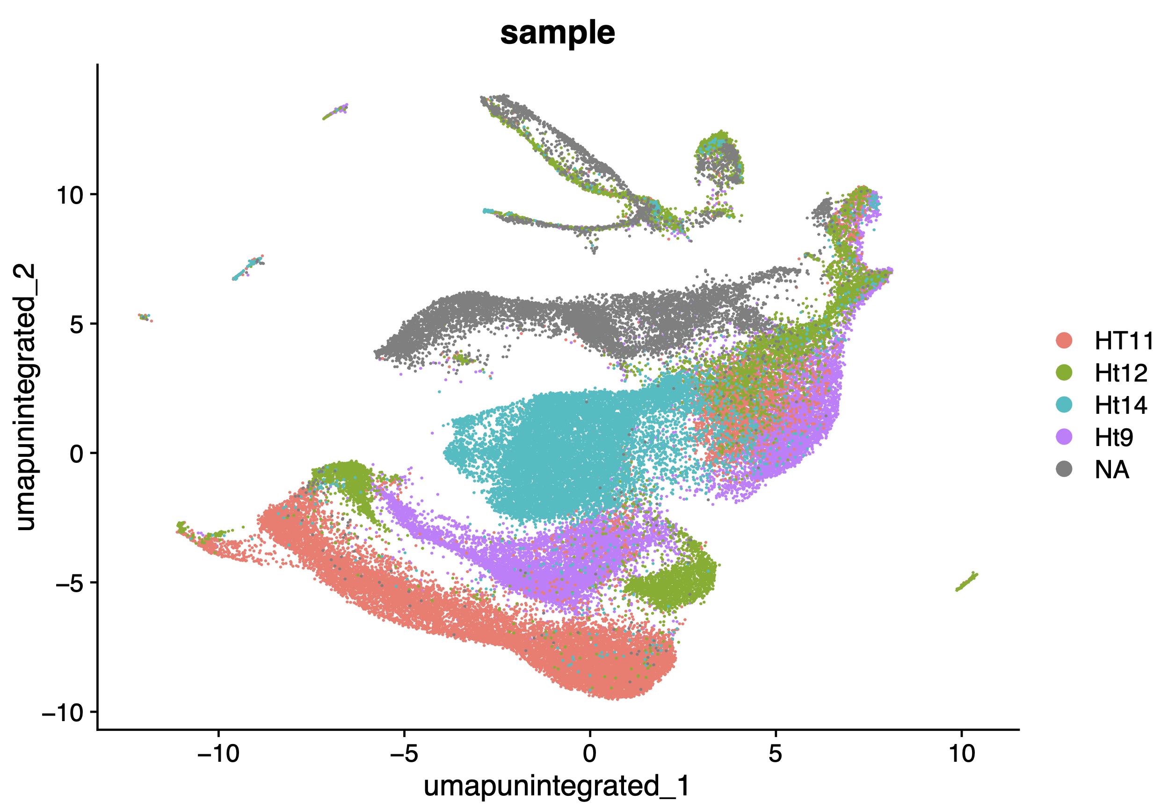
240201_15_split_to_7_samples_first_merged_pre-integrate_group-by-parse

Slide 14
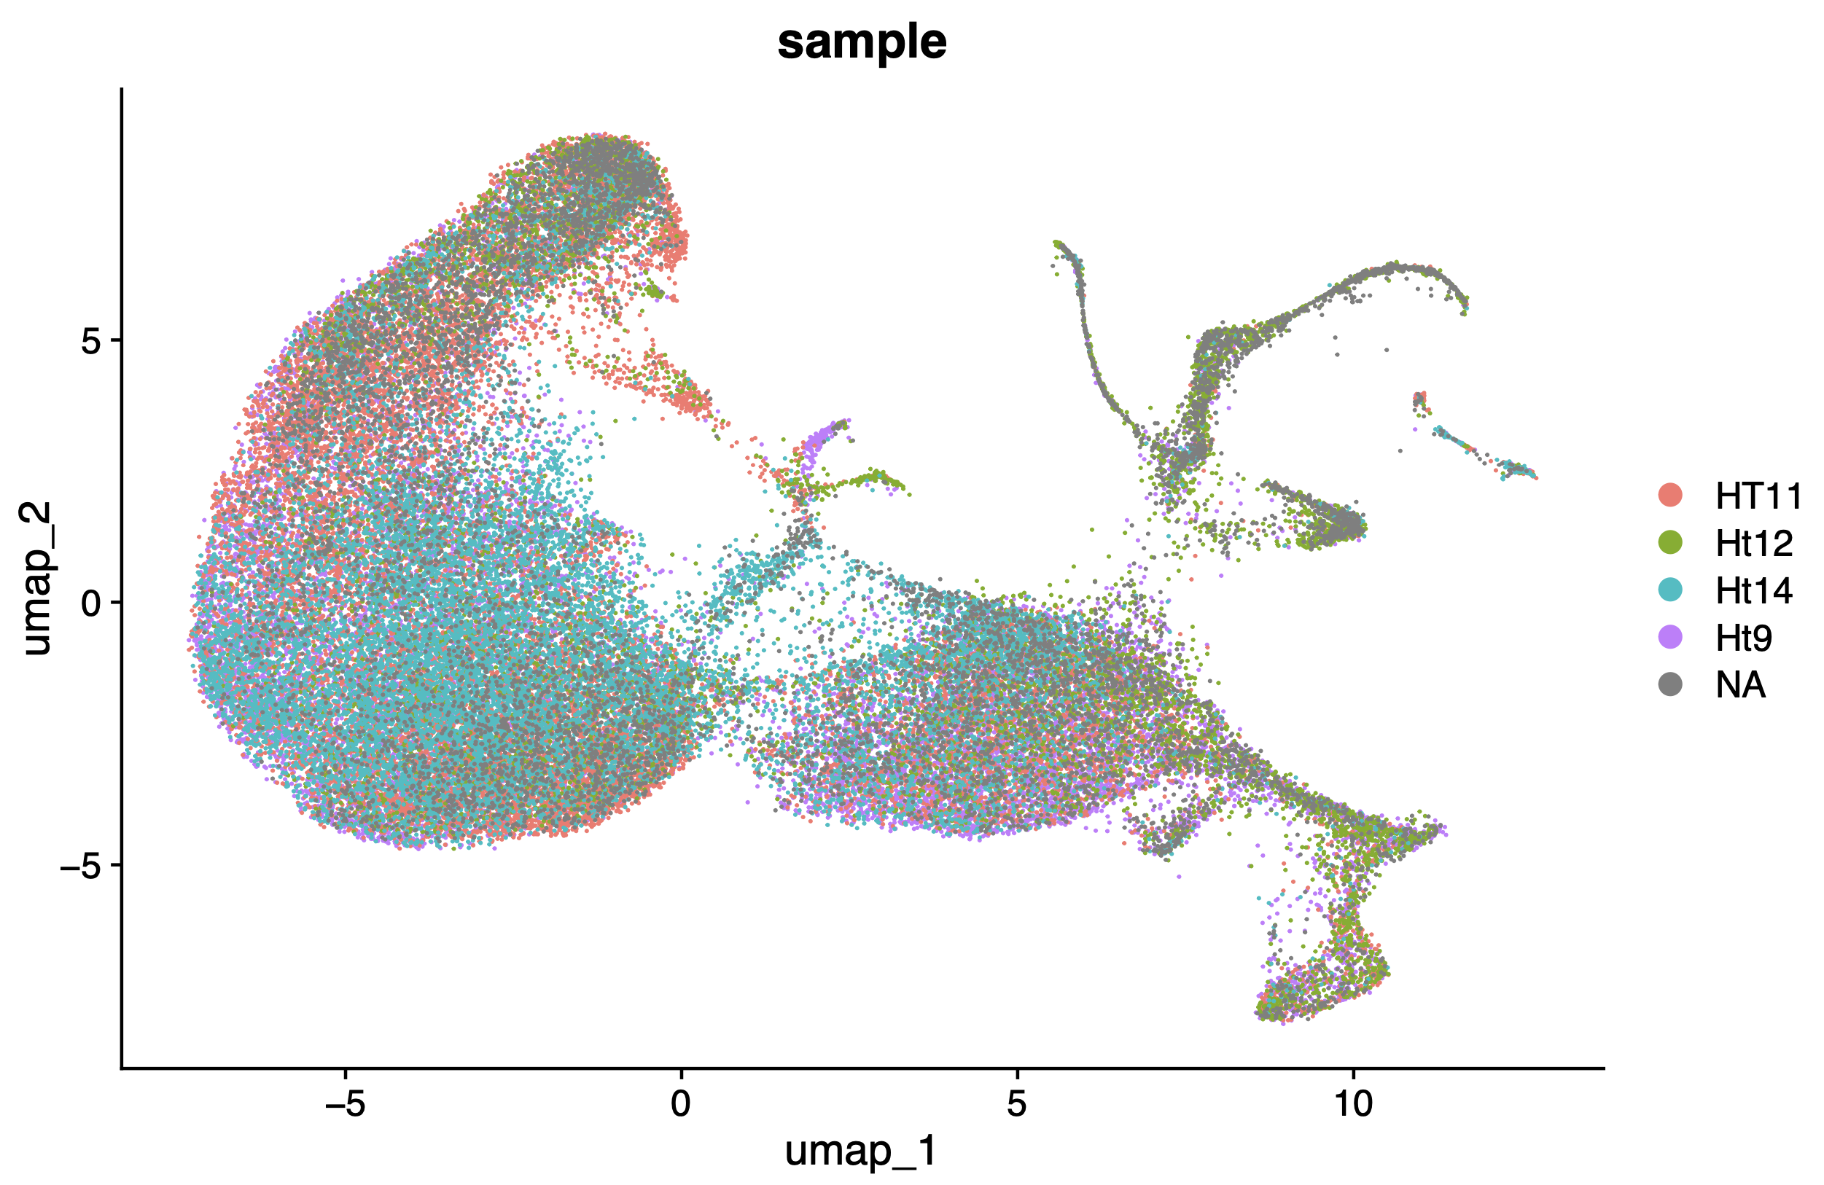
240201_16_split_to_7_samples_first_merged_post-integrate_group-by-parse

Slide 15
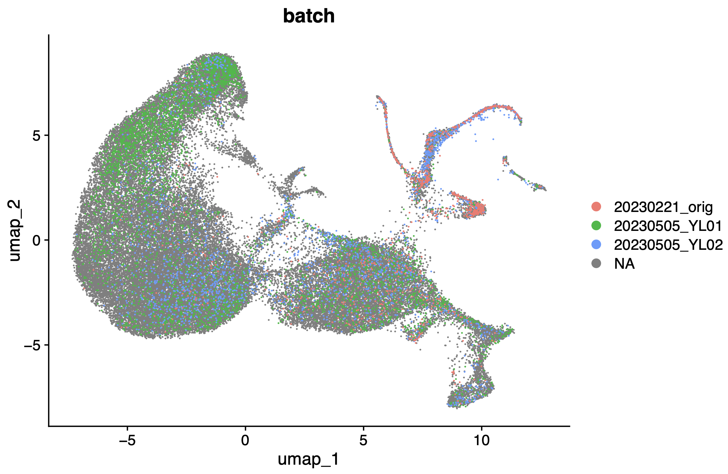
240201_17_split_to_7_samples_first_merged_post-integrate_group-by-multiome

Slide 16
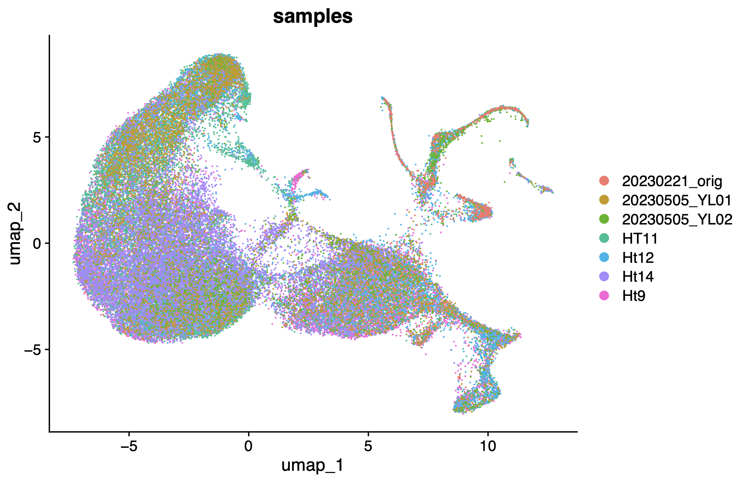
240201_18_split_to_7_samples_first_merged_post-integrate_group-by-all-samples

Slide 17
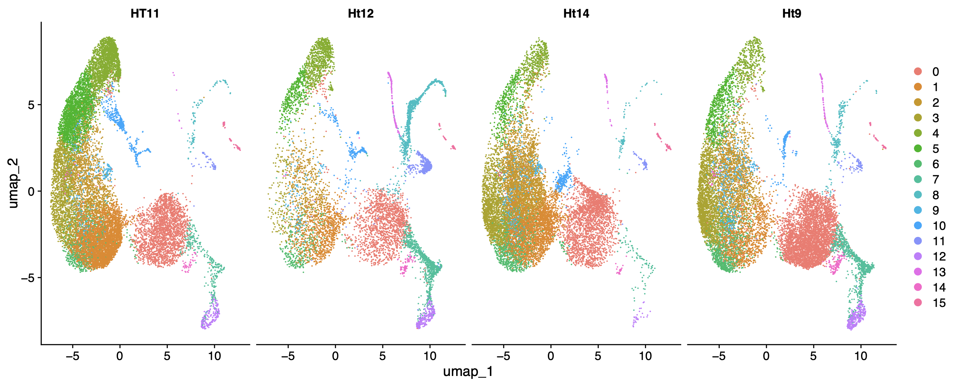
240201_19_split_to_7_samples_first_merged_post-integrate_split-by-parse

Slide 18
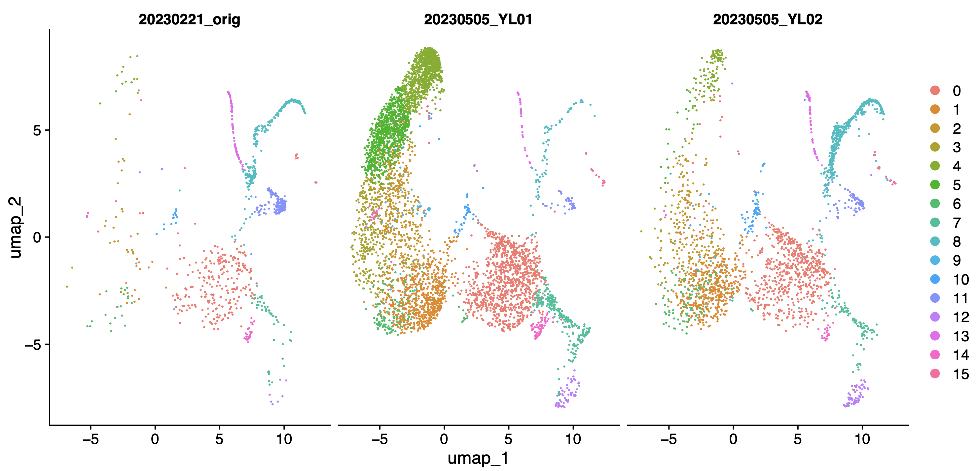
240201_20_split_to_7_samples_first_merged_post-integrate_split-by-multiome

Slide 19
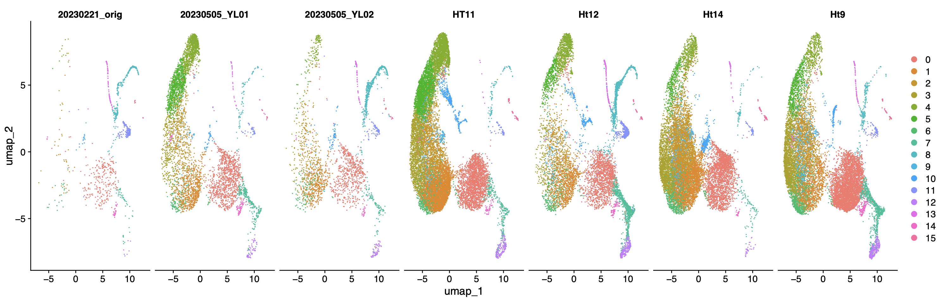
240201_21_split_to_7_samples_first_merged_post-integrate_split-by-all-samples

Slide 20
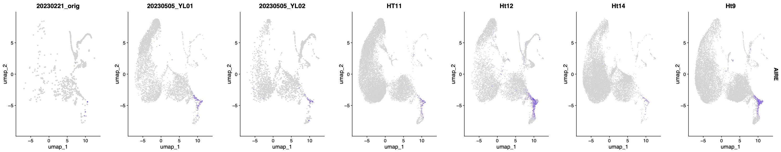
240201_22_split_to_7_samples_first_merged_post-integrate_AIRE

Slide 21
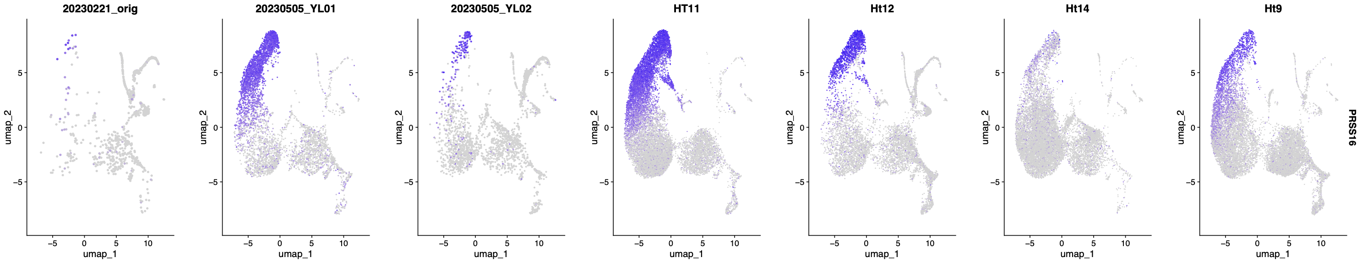
240201_23_split_to_7_samples_first_merged_post-integrate_PRSS16

Slide 22
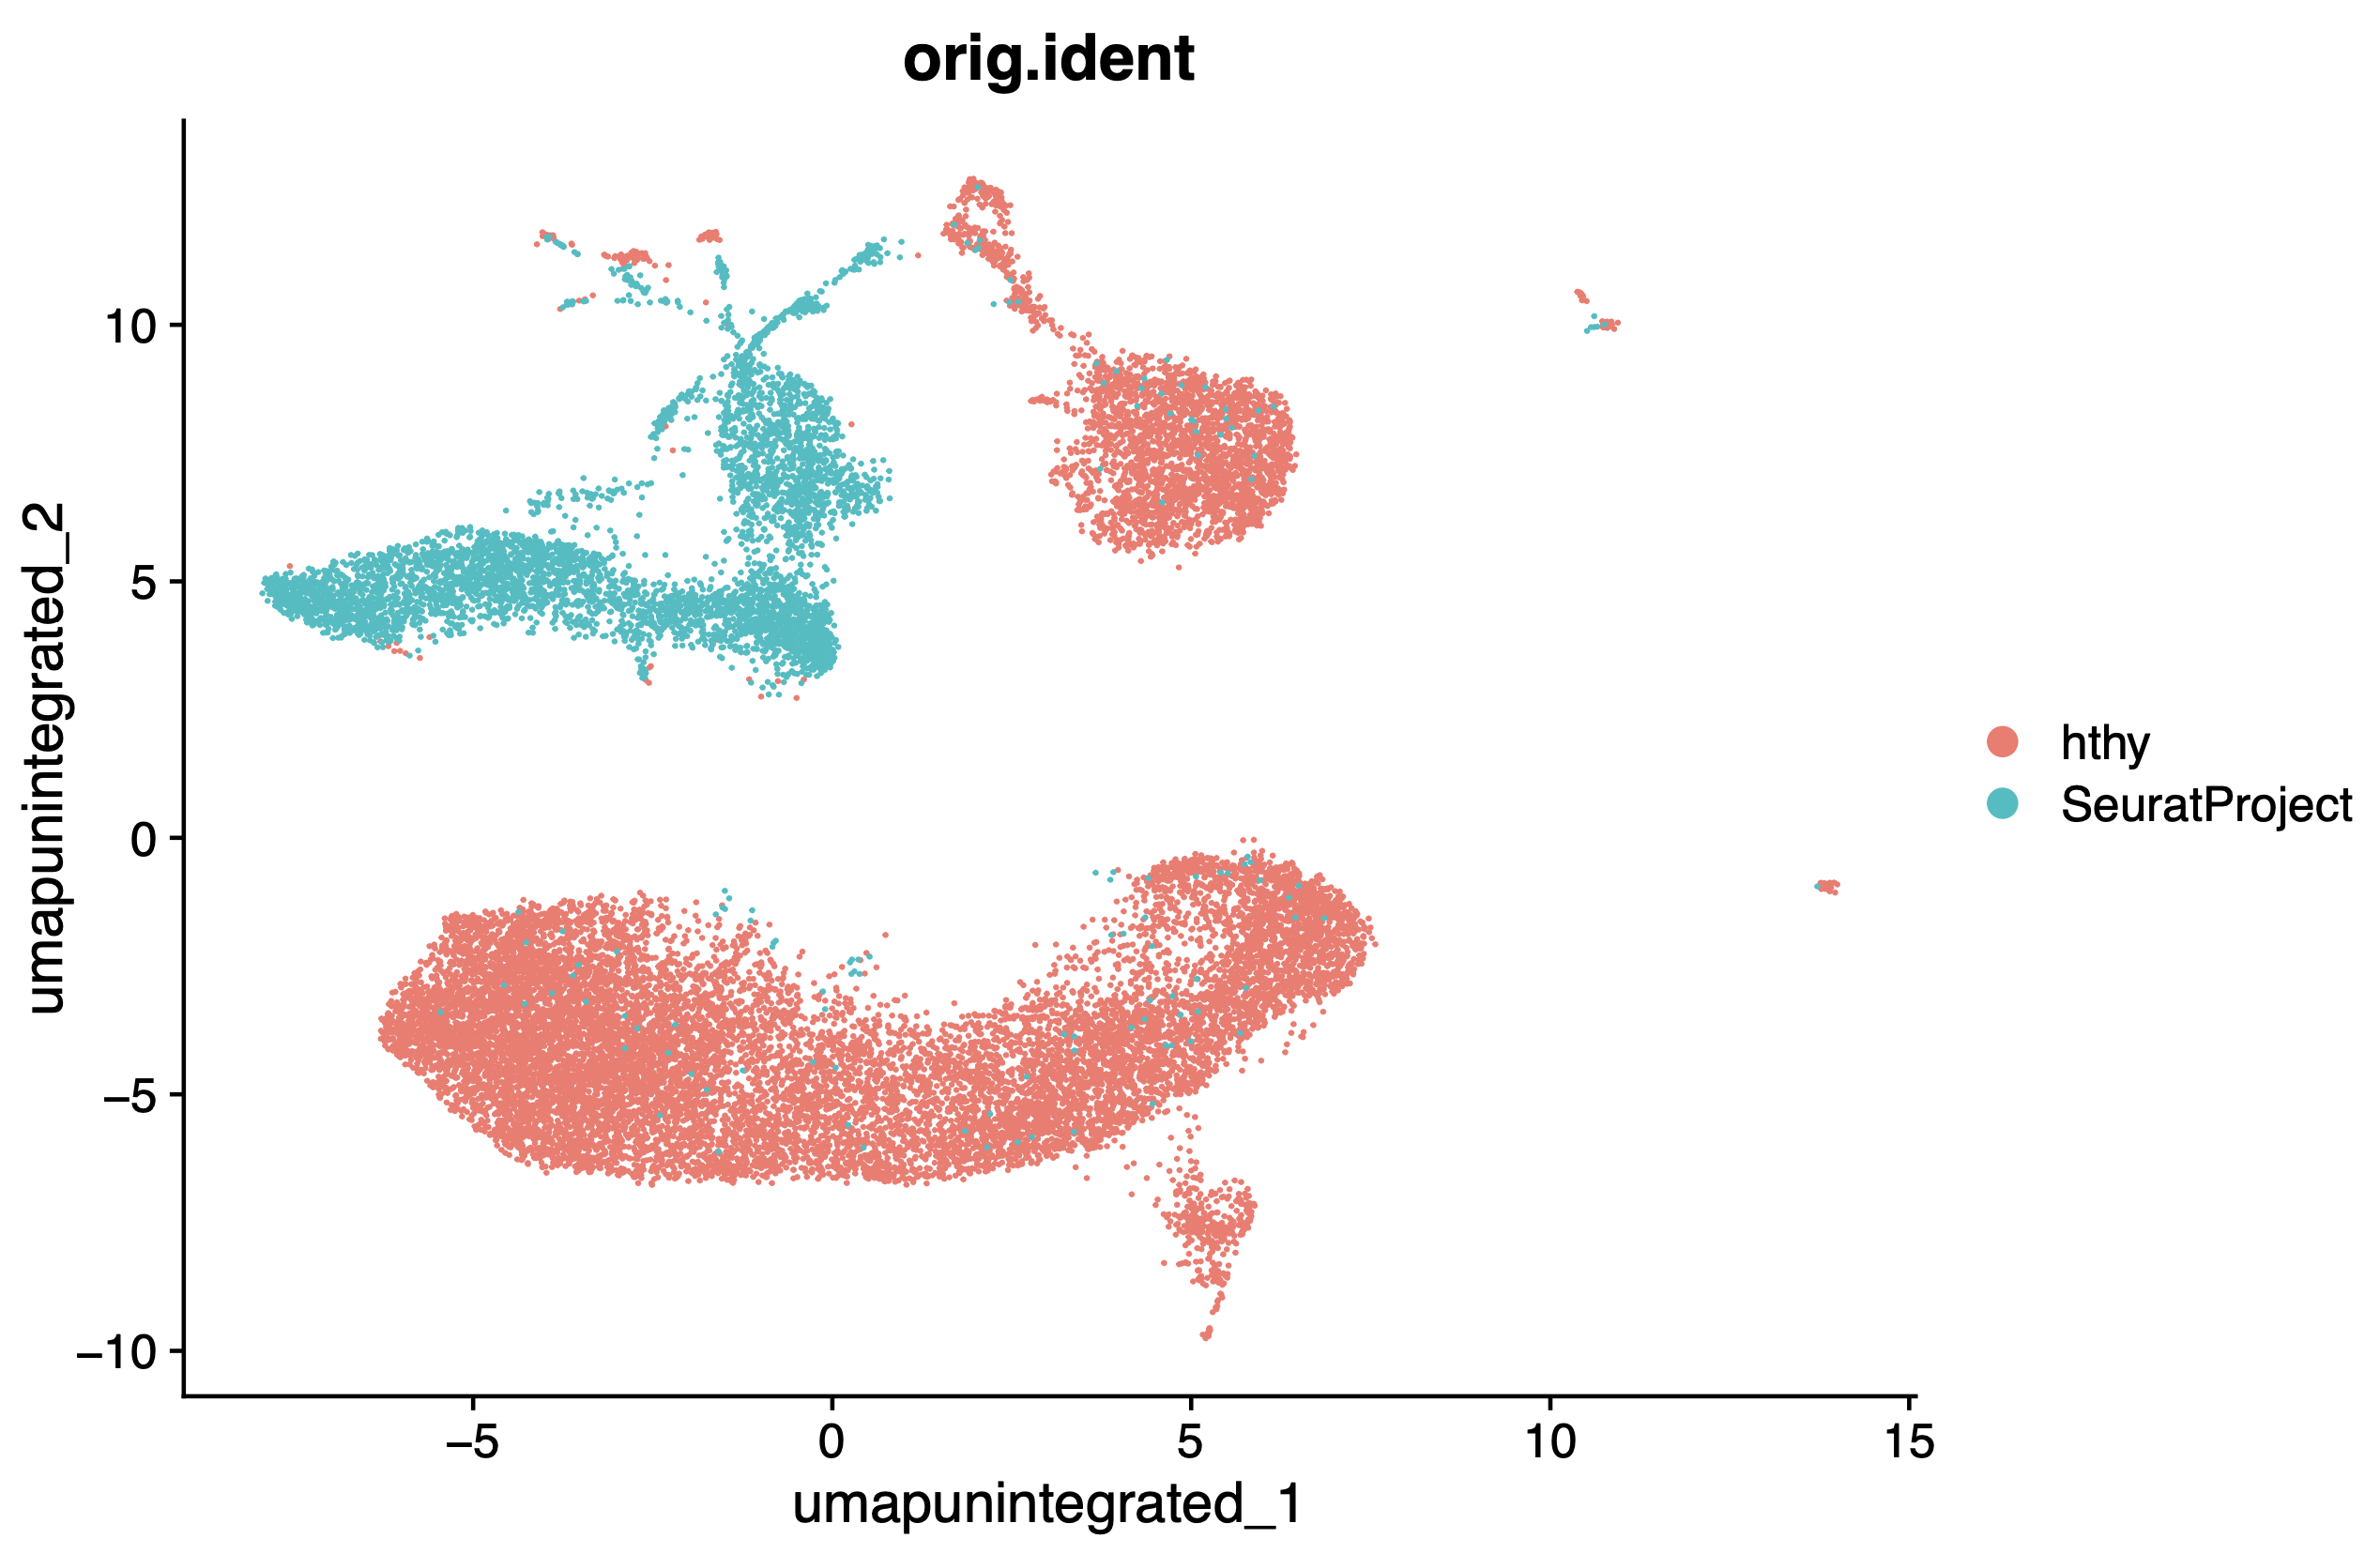
240201_28_ht11_merged_pre-integration_group-by-orig-ident

Slide 23
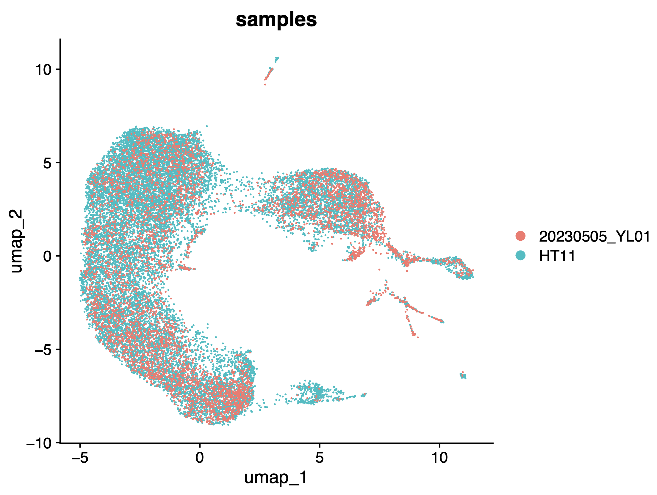
240201_31_ht11_merged_post-integration_group-by-samples

Slide 24
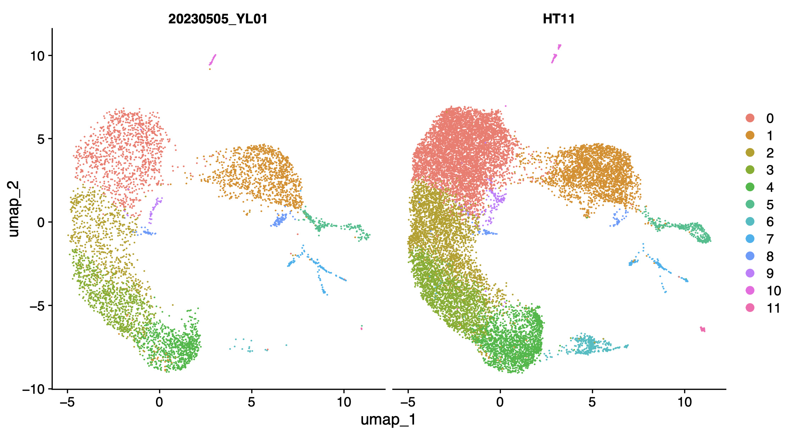
240201_32_ht11_merged_post-integration_split-by-samples

Slide 25
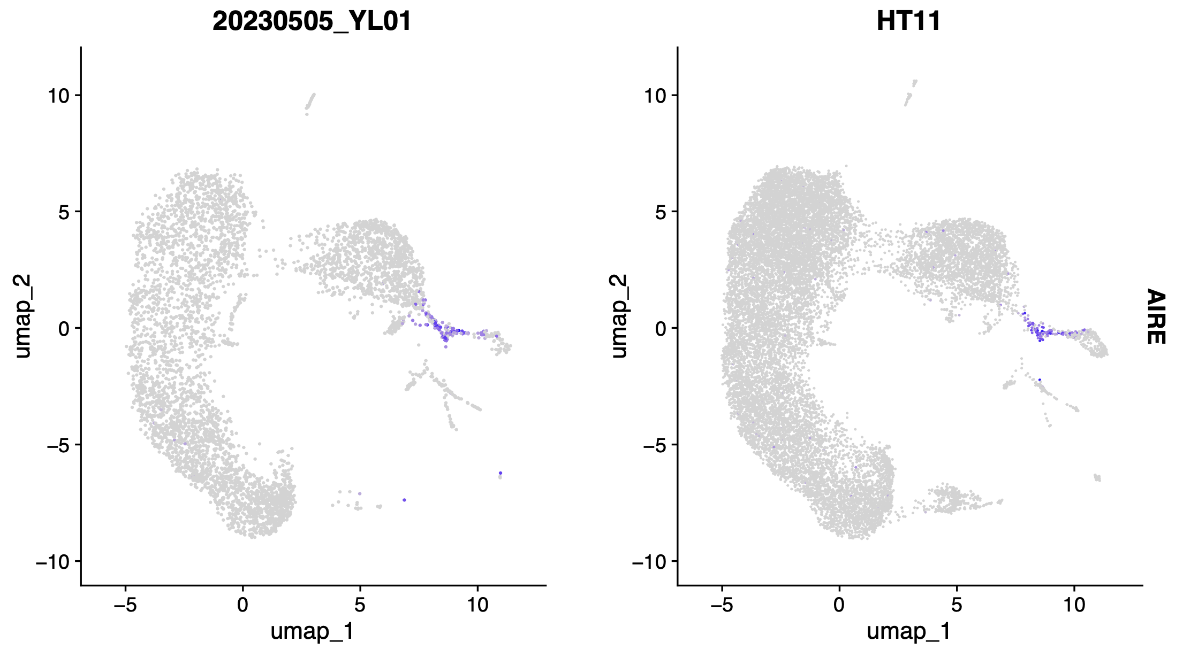
240201_33_ht11_merged_post-integration_AIRE

Slide 26
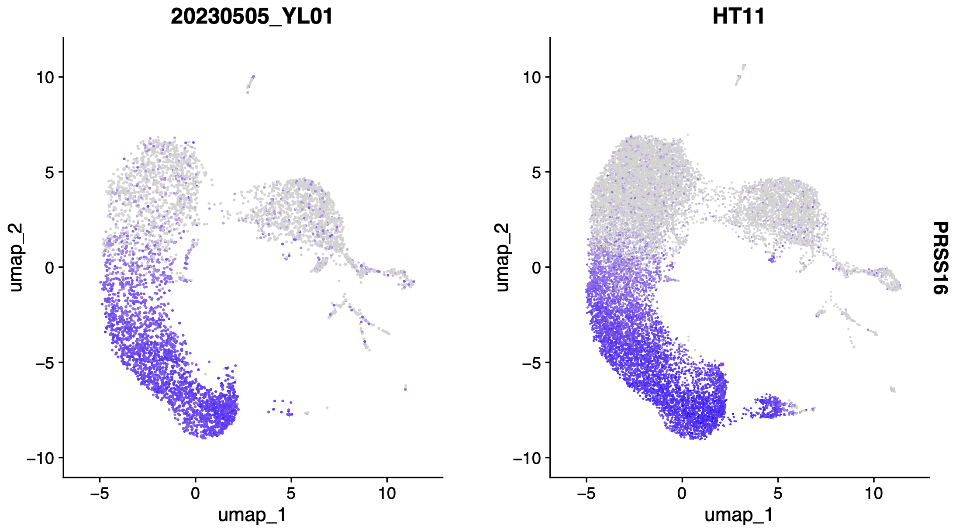
240201_34_ht11_merged_post-integration_PRSS16

